Slide 1
RESUME and COVER Letter

Slide 2
What is a resume?
A resume is a formal document that provides an overview of your professional qualifications, including your relevant work experience, skills, education, and notable accomplishments.
Usually paired with a cover letter, a resume helps you demonstrate your abilities and convince employers you’re qualified and hirable.
The spelling of resume originates from French, and means “summary.”

Slide 3
What is an effective resume?
Makes a first good impression.
Addresses employer’s needs.
Shows prospective employer how he/she will benefit.
Is clear, concise, easy to read.
Attractive presentation & content.

Slide 4
What to include in a resume?
Contact information - It's important to include your name, telephone number, address and email address at the top of your resume. Doing this ensures hiring managers and recruiters can easily locate your information so they can contact you.
Professional summary-This is a short summary of your professional experiences, skills and goals that you may write to reflect the job to which you’re applying. A professional summary is typically two to three sentences long.
Education- You can include the degrees you earn in reverse chronological order. Be sure to include the name of the school, the location and the date you graduated from the program.

Slide 5
Work experience- List your work experience in reverse-chronological order. This section includes your current and former jobs, internships or volunteer work. List each position along with the name of the company and your dates of employment. Underneath each position, you may list your tasks, accomplishments, duties or skills gained in the position.
Skills- This portion of your resume includes hard and soft skills that are relevant to the job for which you’re applying. This may include hard skills like computer programs in which you’re proficient, or soft skills you have developed like leadership or problem-solving.

Slide 6
OPTIONAL RESUME SECTIONS
Certifications and licenses
Languages
Awards and honors
Volunteer work
Publications

Slide 7
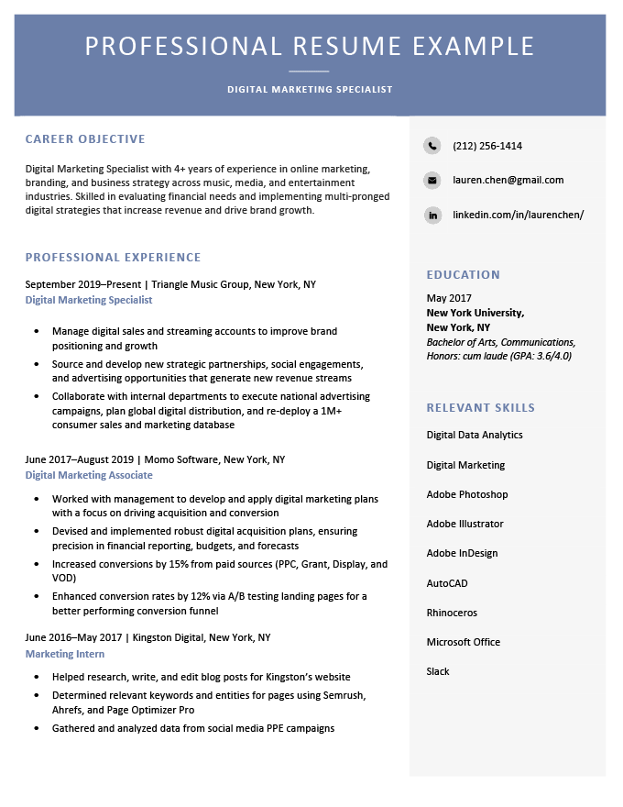

Slide 8
TYPES OF RESUME
There are three main types of resumes:
Chronological resume
Functional resume
Combination resume

Slide 9
Chronological Resume-
Chronological Resume- A chronological resume is a resume type that focuses heavily on your work history. Its key feature is that it lists your work history in order of when you held each position (in chronological order), with your most recent job listed at the top of the section.
The chronological format is the most common type of resume, and is considered the standard for most industries.
A chronological resume is ideal if you have no major gaps between your previous jobs, consistent progression throughout your career, and a long record of accomplishments and skills in the industry you’re applying to.

Slide 10
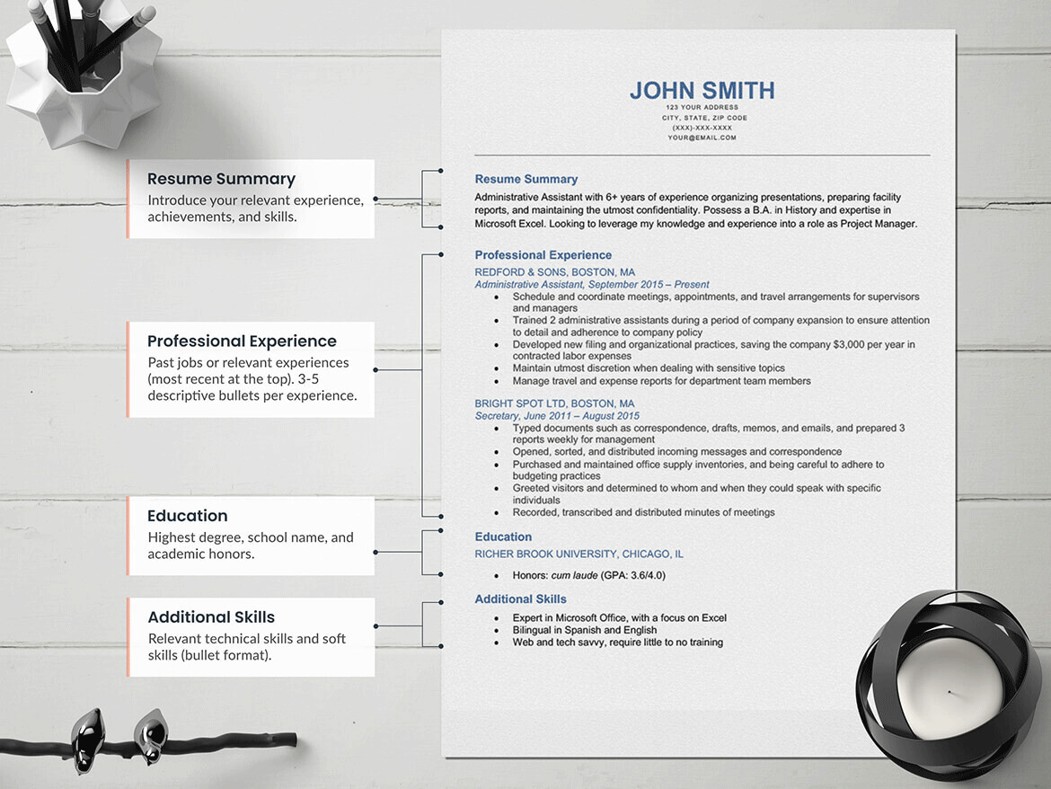

Slide 11
Chronological resume…
Advantages:
Most employers and hiring professionals are familiar with reviewing this type of format. It is easy to follow for the reader, perhaps because the chronological resume is more commonly used.
This type of format highlights the candidates’ most recent experience, which is often the most relevant. It is also easy to follow a career progression with this type of resume.

Slide 12
Chronological resume…
Disadvantages:
If there is a gap or break in the work experience timeline, this format makes that gap stand out.
The chronological resume allows potential employers to figure out if the job applicant has been switching jobs frequently. This is an undesirable attribute in a job candidate.
The format makes it nearly impossible to hide the applicant's age from potential employers. This can be a big disadvantage for both younger and older job seekers.
If a career does not follow a typical progression, this format highlights that problem.

Slide 13
Functional Resume
Functional Resume- A functional resume is a type of resume designed to focus on your relevant professional skills rather than your chronological work history.
The defining feature of a functional resume is its expanded “Relevant Skills” section, which takes up the majority of your resume and replaces a detailed work experience section.
A functional resume will likely suit you if you’re:
Changing industries
Someone with sizeable gaps in your work history

Slide 14
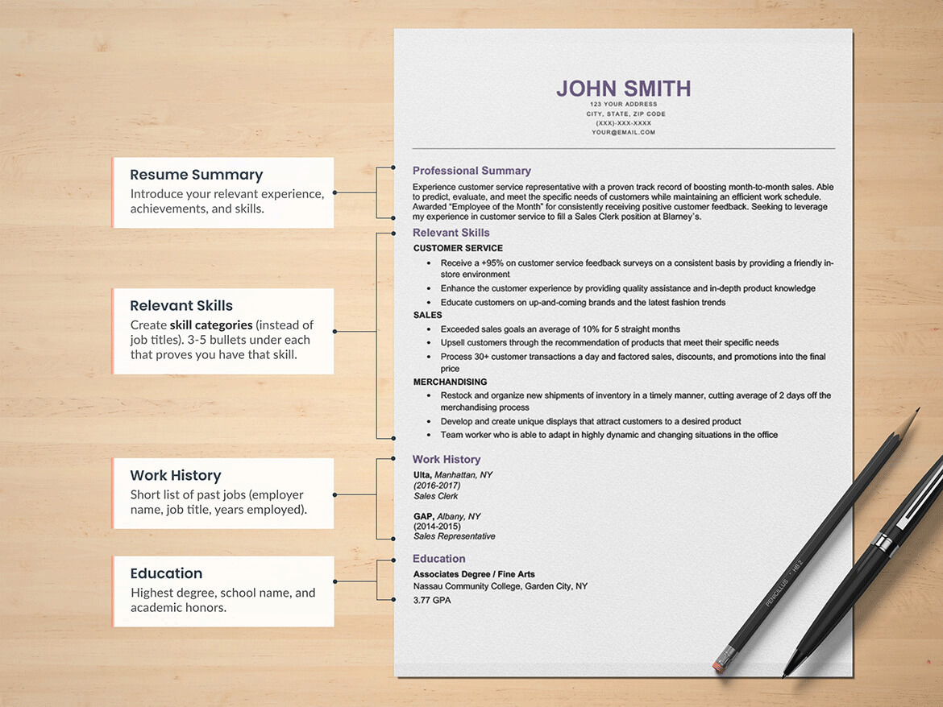

Slide 15
Functional Resume…
Advantages:
If the writer's career path is not immediately apparent, this format can help conceal that perceived "problem."
If someone is new to the workplace, such as a graduating college student, then this format helps to highlight what is known, not where the person has worked.

Slide 16
Functional Resume…
Advantages:
When there are employment gaps, this format can help to conceal this from the reader. Unlike a chronological resume, it isn't necessary to outline where the writer has worked in the past.
If the job applicant has changed jobs frequently, a functional resume can help hide what might look like job-hopping.
Finally, since this format does not bring attention to job titles, it's the ideal approach for someone that might be deemed "overqualified," or is looking for significantly more responsibility.

Slide 17
Functional Resume…
Disadvantages:
The big disadvantage of this format is the hiring manager might be looking for the very information this resume avoids. Unfortunately, this can make the hiring manager suspicious, so it's important to make sure the advantages outweigh the disadvantages before selecting this format.

Slide 18
Combination Resume
Combination Resume- A combination resume mixes the most useful elements of the chronological and functional resume formats.
It focuses on your skills, as a functional resume does, but also provides ample space for you to detail your work history — usually in chronological order.

Slide 19
Cover Letter Writing
A cover letter, also known as an application letter, is a document you send with your resume that provides additional information about skills and experiences related to the job you're applying to.
It typically includes three to four paragraphs that highlight your skills, experience and achievements in relation to the position you’re applying for.

Slide 20
Contents of a Cover Letter
Name of the employer/organization and the person to be contacted should be mentioned at the top-left corner of the page.
Date of the application
Now comes the reference line or the subject of the cover letter which must contain the position you are applying for. For example, “Application for the position of Public Relations Officer.”
Greet the employer directly by writing their name (example: Dear Mr X) instead of writing, “To whomsoever, it may concern”.

Slide 21
Contents of a Cover Letter
After the greeting, start the body of the cover letter by introducing yourself to the reader.
The second paragraph should highlight your educational background and your skills and qualities in a very crisp manner.
Conclude the body of the cover letter by talking about “why should you be hired.”
Lastly, thank the employer and mention your name and contact details.

Slide 22
Opening paragraph- The opening paragraph is your chance to catch the hiring manager’s attention, introduce yourself and express your enthusiasm to a potential employer. Include why you’re excited about the job and the company and how it lines up with your career goals. Include keywords from the job posting and match your skills to the employer’s requirements.
Middle paragraph- Use the middle paragraph to discuss your most relevant experience, highlighting specific qualifications and skills that make you the perfect candidate. In one or two paragraphs, make the connection between your previous accomplishments and your suitability for the role you are applying for.

Slide 23
Closing paragraph- Use the final paragraph to thank the employer for their time and consideration and clarify any details from your resume. For example, if you have employment gaps you can briefly mention this here. You can also use this space to sum up your qualifications for the role and express an interest in continuing to the next stage in the hiring process.

Slide 24
[Your First & Last Names]
[Your Mailing Address]
[Phone Number]
[Email Address]
[Date of Writing]
[Manager’s Name]
[Manager’s Job Title]
[Company’s Name]
[Company’s Street Address]
[City, State, and Zip Code]

Slide 25
Subject: Job Application Letter for the Position of _____________
Dear Mr. Appleton,
Dear Mr. Jones
Dear Ms. Brown
Dear Riley Doe
Dear Dr. Haven
Dear Professor Lawrence
When you don’t know the hiring manager’s name
“Dear Client Services Manager,”
“Dear Vice President of Business Development,”
“Dear Sales & Marketing Director:”

Slide 26
Introduction examples…
As a recent graduate of Western Michigan University with a degree in business-oriented chemistry, I was excited to see your listing on Indeed for a Marketing Associate at AMCOL Corp.
As a cybersecurity expert with 3 years of experience in online banking systems, I am seeking a new opportunity and was intrigued by your job listing for a Cybersecurity Consultant.

Slide 27
Introduction examples…
As a responsible and organized NNA-trained notary, I am writing to apply for the Notary Public position with PRA Group listed on LinkedIn.
After speaking with my former colleague Mary Waltman about the open Real Estate Agent position at Weichert Co., I decided I couldn’t miss out on such an exciting opportunity and am writing to express my interest in joining your agency.

Slide 28
Introduction examples…
I came across your job advertisement for a marketing manager on the Indeed job board, and I am interested in working with you. I am a seasoned marketer with a first-class MBA and seven years of work experience with the Cody Cola drinks company. Given my extensive knowledge of planning strategies, managing budgets and implementing marketing campaigns, I know I can fit in and meet the high expectations of your marketing department."

Slide 29
Concluding Para…
I’ve attached my resume so that you can review my education and experience. I hope to hear from you soon. Thank you very much for your time and consideration.
Respectfully,
Signature (hard copy letter)
Name of the Applicant

Slide 30
have enclosed my resume, detailed profile and a certificate of experience for your reference and review. I have also provided my contact information. Please feel free to contact me in case of any questions. I am looking forward to meeting with you in person for an interview.
Thank you for your time and consideration.
Yours sincerely,

Slide 31
I’ve attached my resume, which further details, my skills and educational background. Please don’t hesitate to reach out if you have any questions about my background. I look forward to the opportunity to speak with you further; thank you for your time and consideration.
Sincerely,

Slide 32
Subject: Application for ________ position
Dear Mr/Ms/Mrs (Manager’s Name)
My name is _______. I came across the recent opening for _______(job position) on LinkedIn and I believe that the role describes me perfectly. I have always been interested in the workspace that your organization is known to have in the market. I am seeking a challenging, competitive yet friendly environment and I truly believe that working at your organization will be an enriching experience.

Slide 33
I have studied ________ (course) at _______ (university/college name) and I have recently completed a 3-month internship at _______ where I was a part of _______ team. It helped me learn about the type of roles and responsibilities in the field of ______, the work ethics that need to be followed as well as deadlines that need to be adhered to. I possess excellent communication and team working skills.
I have attached my resume along with the cover letter which contains my educational and professional qualifications. I will give a call to your office the next week to know more about the job profile. You can also reach out to me at the contact details mentioned in the resume.
Sincerely,
Name

Slide 34
Dear Ms. Cummings:
I am responding to your recent request in the Arkansas Democratic-Gazette for a Business Consultant. As you can see from my current background and educational experience, I am a qualified candidate for this position.
Currently, I am a faculty member in the Department of Management and Aviation Science at Henderson State University. I am also engaged in several temporary assignments involving the installation, conversion, and maintenance of automated accounting systems, troubleshooting, and training. I have working knowledge of, and have taught several applications and operating systems. This includes, but is not limited to, the use of electronic spreadsheets (1-2-3, Excel, Quattro, etc.), and word processing and accounting (Peachtree, AccPac, Great Plains, MYOB, Quicken, Quickbooks, One-Write Plus, etc.) in Windows, Mac, and traditional DOS (IBM/PC) environments.

Slide 35
In strategic market development, the ability to assess customer needs relative to overall market conditions and to respond to them rapidly is critical for successful business development. Let me provide you with innovative approaches to getting the job done based on action, not words.
I would like the opportunity to help you increase your value-added services and profitability. I look forward to discussing this further.
Sincerely,
John Balance
Enc. resume

Slide 36
Mr. Kapoor Brainside Link Road, Andheri, Mumbai,-400053 (xxx)xxxxxxx recruiter@gmail.com
Subject: Application for the Counselor Position at Brainside
Dear Recruiter’s Name, I am excited to write this letter about the job opening as a counsellor at Brainside. I chanced upon your company’s opening on LinkedIn and upon reading the required qualities, I certainly believe I meet those requisite skills.

Slide 37
I have completed my M.A in Psychology from KC College, Mumbai, and have also completed various certificate courses in REBT and CBT which add to my field of expertise. I hold a CGPA of 7.0 and have maintained above-average scores consistently throughout my master’. Being passionate about my subject, I also invested considerable time in assisting senior psychologists and learning from them at every step.
I have also attached my resume and certainly believe that my skills and education qualifications make me fit for the position of counsellor. I assure you that I’ll put my best foot forward and conform with the team.

Slide 38
I’m grateful for this opportunity and waiting in anticipation for discussing the position in detail. My contact details are mentioned above for your reference.
Thank you.
Respectfully, Rishi Sharma

Slide 39
Anne Galindo
123-456-7890
anne.smith@email.com
January 23, 2021
Dear Hiring Manager,
I’m excited to be applying for the web developer position at [Company Name]. I’ve been programming websites and using CSS to create user-friendly experiences since I was in middle school, so it’s always been a passion of mine. I’ve also been intrigued by your company ever since it won Most Innovative at the National Web Development Awards two years ago. I strive to stay on the cutting-edge of web design and development, so when I saw this job posting, I knew I had to apply.

Slide 40
During my previous role at [Company Name], I built a website completely from scratch for a recently rebranded business, both ahead of schedule and within budget. I started by gathering requirements from my clients and holding a focus group to perform user research. My favorite part about web design is building a solution that impresses the client and meets the needs of users and customers.
My new website was responsive, lightning-fast, and included the latest e-commerce features. After launch, I continued to lead optimization efforts. Through A/B testing, I improved the click-through rate by 10% and reduced the bounce rate on the website’s landing page by 35%. As your web developer, I would bring these skills to develop websites that exceed the expectations of clients and customers and drive real business results.

Slide 41
One of the factors that attracted me to this role is that [Company Name] values giving back to the community. In my spare time, I run free web development workshops for at-risk youths. In these workshops, I teach them the basics of HTML/CSS and JavaScript and serve as a mentor. As I grow in my career, applying my skills to help others and make an impact on the world becomes more important—I believe this role would give me that opportunity.
Thank you for your consideration and time. I look forward to learning more details about the position and company.
Sincerely,
Anne Galindo

